Slide 1
THEMIS: A Mutually Verifiable Billing System
for the Cloud Computing Environment

Slide 2
Modules
User Interface Design
Cloud Service Provider
User

Slide 3
Modules Description
User Interface Design
User Interface Design have a purpose that a user to move from login page to user page of the website. In this we want to enter our user name and password provided by Service provider.
If we enter the valid password and user name then only the user can move login page to user window while entering user name and password it will check username and password is match or not. If we enter any wrong username or wrong password it generates some error message.
So we are preventing from unauthorized user entering into the service provider website. It will provide a good security for our project.
Service provider contain user name and password server also check the authentication of the user. It will improve the security and preventing from unauthorized user enters into the website.
In our project we are using java swings for creating design. Here we are validating the users who are going to access the Service providers.

Slide 4
Module Diagrams
User Interface Design
LOGIN
Validation
Cloud Service Provider
USER
Database
Client Account page

Slide 5
Modules Description
Cloud Service Provider
Service provider has a job of providing a service like software to the cloud users. In our proposed method, CSP doesn’t provide billing transaction to the user.
It is due to the reason if billing transaction performed in the CSP then complexity in security to be provided for billing transaction increases the overhead. If the user logged in for service, CSP validate the user whether he\she is an authenticated user or not.
Once if user is found authenticated user then it waits for service check in message else it found any unauthenticated user it will send the error message.
If it received the service check in message then it responds the user by transmitting the agreement and hash chain (one time key). After getting the service request from the user, CSP provide the requested service to the user.
It is also have a contact with the Cloud notary authority. It will provide the service until it receive the service checkout message. The CSP enables users to scale their capacity upwards or downwards regarding their computing requirements and to pay only for the capacity that they actually use.

Slide 6
Module Diagrams
Cloud Service Provider
CSP
Software services
User details
Check in
Service details
Contract + Hash chain
USER
Database

Slide 7
Modules Description
User
User can access a service from the Cloud Service Provider by authenticated login process. We assume that users are thin clients who use services in the cloud computing environment.
To start a service session in such an environment, each user makes a service check-in request to the CSP with a billing transaction.
To end the service session, the user can make a service check-out request to the CSP with a billing transaction. Once if the users send the service check-in message it can get the contract from the CSP.
After receiving the one time keywords in the contract it can be able to access the service from the CSP. Now user log details are stored in Monitor for future disputes.
After accessing the service, user want billing transaction. If he\she wants the bill means it should send the contract of the CSP with contract of the user to the CNA.
If both the details checked by the CNA are identical then user can receive the bill binding information along with confirmation message. If any error occurred or forgery activity found from the user side then the user will receive the penalty for that.

Slide 8
Module Diagrams
User
USER
CHECK IN
CSP
CSP Details
CNA Details
Service logs
SLA Detail
Contract of CSP + USER
CNA

Slide 9
GIVEN INPUT EXPECTED OUTPUT
User Interface Design
Input:
Registration
Username
Password
Output:
Registered in Database
Login successfully
Open client home page
Cloud Service Provider
Input:
Check-in message
User response with one time key
Output:
Contract including SLA and Hash chain
Software Service

Slide 10
GIVEN INPUT EXPECTED OUTPUT
User
Input:
Contract and Hash chain from CSP
Access software from CSP
Output:
Response to csp with Hash chain
Send contract of user and CSP to CNA

Slide 11
User Interface Design
<!DOCTYPE html PUBLIC "-//W3C//DTD XHTML 1.0 Transitional//EN" "http://www.w3.org/TR/xhtml1/DTD/xhtml1-transitional.dtd">
<html xmlns="http://www.w3.org/1999/xhtml">
<head>
<title>Cloud Service Provider</title>
<meta http-equiv="Content-Type" content="text/html; charset=utf-8" />
<link href="css/style.css" rel="stylesheet" type="text/css" />
<link rel="stylesheet" type="text/css" href="css/coin-slider.css" />
<script type="text/javascript" src="js/cufon-yui.js"></script>
<script type="text/javascript" src="js/droid_sans_400-droid_sans_700.font.js"></script>
<script type="text/javascript" src="js/jquery-1.4.2.min.js"></script>
<script type="text/javascript" src="js/script.js"></script>
<script type="text/javascript" src="js/coin-slider.min.js"></script>
<script type="text/javascript" src="Validation.js"></script>

Slide 12
<link rel="stylesheet" type="text/css" href="style.css" media="screen" />
</head>
<body>
</script>
<script language="javascript">
function validate_register()
{
var a=document.getElementById("name");
var b=document.getElementById("password");
var c=document.getElementById("uname");
var d=document.getElementById("rpass");
var e=document.getElementById("phone");
var f=document.getElementById("email");
var g=document.getElementById("addr");
var h=document.getElementById("acc");
var n=e.value.length;
var ac=h.value.length;
var em=f.value;
var a1=em.indexOf("@");
var b1=em.indexOf(".");
var numbers = /^[0-9]+$/;
if(a.value=="")

Slide 13
else if(c.value=="")
{
alert("Enter the Username");
c.focus();
return false;
}
else if(b.value=="")
{
alert("Enter the Password");
b.focus();
return false;
}
else if(d.value=="")
{
alert("Enter the Confirm Password");
d.focus();
return false;
}
else if(d.value!=b.value)
{
alert("MisMatch Password");
d.focus();
return false;
}

Slide 14
else if(!e.value.match(numbers))
{
alert(numbers);
alert("Phone Number must be Number");
e.focus();
return false;
}
else if(f.value=="")
{
alert("Enter the Email");
f.focus();
return false;
}
else if(a1>b||a1==-1||b1==-1)
{
alert("Enter the Proper MailID");
f.focus();
return false;
}

Slide 15
else if(g.value=="")
{
alert("Enter the Address");
g.focus();
return false;
}
else if(h.value=="")
{
alert("Enter the Account Number");
h.focus();
return false;
}
else if(!h.value.match(numbers))
{
alert(numbers);
alert("Phone Number must be Number");
e.focus();
return false;
}

Slide 16
<div class="header">
<div class="header_resize">
<div class="searchform">
<div class="top_menu"> </div>
</div>
<div class="logo">
<h1><a href="#">Cloud<span>Service Provider</span></a></h1>
</div>
<div class="clr"></div>
<div class="menu_nav">
<ul>
<li class="active"><a href="Home.jsp"><span>Home Page</span></a></li>
<li><a href="support.jsp"><span>Support</span></a></li>
<li><a href="about.jsp"><span>About Us</span></a></li>
<li><a href="contact.jsp"><span>Contact Us</span></a></li>
</ul>
</div>
<div class="clr"></div>
<div class="slider">
<div id="coin-slider">

Slide 17
<a href="#"><img src="images/slide1.jpg" width="960" height="360" alt="" />
<span>
<big>
Billing System
</big>
<div class="clr"></div>
</div>
<div class="clr"></div>
</div>
</div>
<div class="content">
<div class="content_resize">
<div class="mainbar">
<div class="article">
<h2><span>Excellent Solution</span> For Your Billing System</h2>
<div class="clr"></div>
<div class="img"><img src="images/img1.jpg" width="236" height="245" alt="" class="fl" /></div>
<div class="post_content">
<p><br/>
We built a billing management system that allows

Slide 18
<img src="images/checked.gif">Get real-time insight into orders & revenue<br/>
<img src="images/checked.gif">Manage the dunning process when cards fail<br/>
<img src="images/checked.gif">Handle free trials, promotions, refunds & more<br/>
<img src="images/checked.gif">Charge customers on a per-usage basis<br/>
</p>
</div>
</div>
</div>
<div class="sidebar">
<div class="gadget">
<h2 class="star"><span></span>Registration</h2>
<div class="clr"></div>
<ul class="sb_menu">

Slide 19
Cloud Service Provider
* Servlet implementation class CSP_Homepage
*/
public class CSP_Homepage extends HttpServlet {
private static final long serialVersionUID = 1L;
/**
* @see HttpServlet#HttpServlet()
*/
public CSP_Homepage() {
super();
// TODO Auto-generated constructor stub
}
/**
* @see HttpServlet#doGet(HttpServletRequest request, HttpServletResponse response)

Slide 20
protected void doPost(HttpServletRequest request, HttpServletResponse response) throws ServletException, IOException
{
String admin_name=request.getParameter("username");
String admin_pass=request.getParameter("password");
HttpSession hs=request.getSession();
hs.setAttribute("username", admin_name);
if((admin_name.equalsIgnoreCase("admin"))&&(admin_pass.equalsIgnoreCase("admin")))

Slide 21
public class Upload extends HttpServlet {
protected void processRequest(HttpServletRequest request, HttpServletResponse response)
throws ServletException, IOException {
response.setContentType("text/html;charset=UTF-8");
PrintWriter out = response.getWriter();
ServletContext context=getServletContext();
try
{
String contentType = request.getContentType();
System.out.println("content type "+contentType);
if ((contentType != null) && (contentType.indexOf("multipart/form-data") >= 0)) {
DataInputStream in = new DataInputStream(request.getInputStream());
//we are taking the length of Content type data
int formDataLength = request.getContentLength();
byte dataBytes[] = new byte[formDataLength];
int byteRead = 0;

Slide 22
int totalBytesRead = 0;
//this loop converting the uploaded file into byte code
while (totalBytesRead < formDataLength)
{
byteRead = in.read(dataBytes, totalBytesRead, formDataLength);
totalBytesRead += byteRead;
}
fileSize=dataBytes.length;
String file = new String(dataBytes);
//for saving the file name
// System.out.println("file is nnnnnnnnnnn="+file+"xxxxxxxxxxxxxxx");
String saveFile = file.substring(file.indexOf("filename=\"") + 10);
// System.out.println("save file is "+file);
saveFile = saveFile.substring(0, saveFile.indexOf("\n"));
saveFile = saveFile.substring(saveFile.lastIndexOf("\\") + 1, saveFile.indexOf("\""));
int lastIndex = contentType.lastIndexOf("=");
String boundary = contentType.substring(lastIndex + 1, contentType.length());
int pos;

Slide 23
<body>
<script language="javascript">
function validate()
{
var a=document.getElementById("name");
var b=document.getElementById("pass");
if(a.value=="")
{
alert("Enter the Username");
a.focus();
return false;
}
else if(b.value=="")
{
alert("Enter the Password");
b.focus();
return false;
}

Slide 24
User
<!DOCTYPE html PUBLIC "-//W3C//DTD XHTML 1.0 Transitional//EN" "http://www.w3.org/TR/xhtml1/DTD/xhtml1-transitional.dtd">
<html xmlns="http://www.w3.org/1999/xhtml">
<head>
<title>Cloud Service Provider</title>
<meta http-equiv="Content-Type" content="text/html; charset=utf-8" />
<link href="css/style.css" rel="stylesheet" type="text/css" />
<link rel="stylesheet" type="text/css" href="css/coin-slider.css" />
<script type="text/javascript" src="js/cufon-yui.js"></script>
<script type="text/javascript" src="js/droid_sans_400-droid_sans_700.font.js"></script>
<script type="text/javascript" src="js/jquery-1.4.2.min.js"></script>
<script type="text/javascript" src="js/script.js"></script>
<script type="text/javascript" src="js/coin-slider.min.js"></script>
<link rel="stylesheet" type="text/css" href="style.css" media="screen" />
</head>

Slide 25
<body>
<script language="javascript">
function validate()
{
var a=document.getElementById("name");
var b=document.getElementById("pass");
if(a.value=="")
{
alert("Enter the Username");
a.focus();
return false;
}
else if(b.value=="")
{
alert("Enter the Password");
b.focus();
return false;
}

Slide 26
<ul>
<li class="active"><a href="Home.jsp"><span>Home Page</span></a></li>
<li><a href="support.jsp"><span>Support</span></a></li>
<li><a href="about.jsp"><span>About Us</span></a></li>
<li><a href="contact.jsp"><span>Contact Us</span></a></li>
</ul>
</div>
<div class="clr"></div>
<div class="slider">
<div id="coin-slider">
<a href="#"><img src="images/slide1.jpg" width="960" height="360" alt="" />
<span>
<div class="sidebar">
<div class="gadget">
<h2 class="star"><span></span>Login</h2>
<div class="clr"></div>
<ul class="sb_menu">

Slide 27
<div class="fbg">
<div class="fbg_resize">
<div class="col c1"> <ul class="fbg_ul">
<li><a href="http://en.wikipedia.org/wiki/Cloud_computing">Cloud Computing</a></li>
<li><a href="http://searchdatabackup.techtarget.com/definition/cloud-backup">cloud backup</a></li>
<li><a href="http://searchcloudcomputing.techtarget.com/definition/cloud-computing">Hybrid cloud.</a></li>
</ul>
</div>
<div class="col c3">
<h2><span>Contact</span> Us</h2>
<p></p>
<p class="contact_info"> <span>Address:</span>1458 chennai, India<br />
<span>Telephone:</span> +123-1234-5678 <img src="images/images (1).jpg" width="18" height="16" alt="" /><br />
<span>FAX:</span> +458-4578<br />
<span>Others:</span> +301 - 0125 - 01258<br />
<span>E-mail:</span> <a href="#">abc@cloud.com</a> </p>

Slide 28
</div>
<div class="clr"></div>
</div>
</div>
<div class="footer">
<div class="footer_resize">
<div style="clear:both;"></div>
</div>
</div>
</div>
<div align=center></div></body>
</html>

Slide 29
USER INTERFACE DESIGN

Slide 30
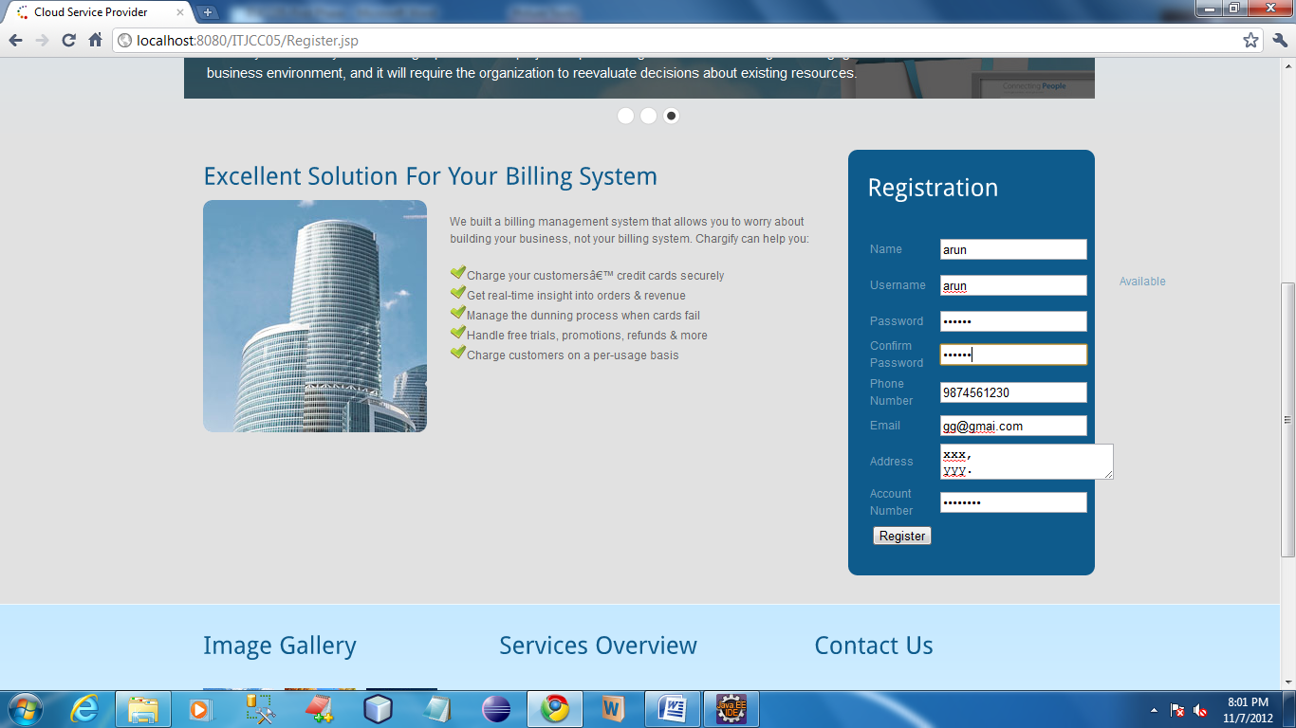

Slide 31
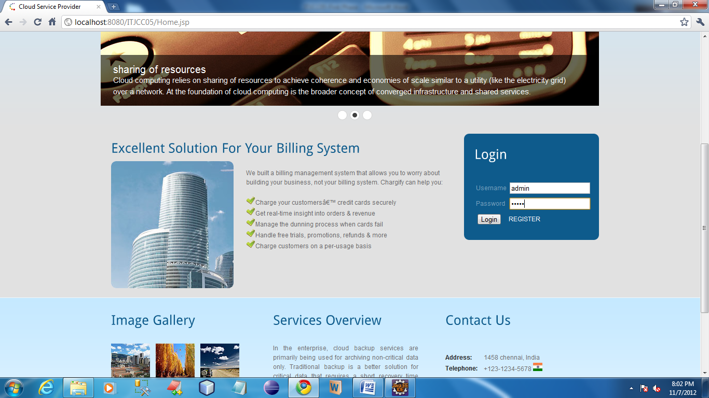

Slide 32
CSP

Slide 33
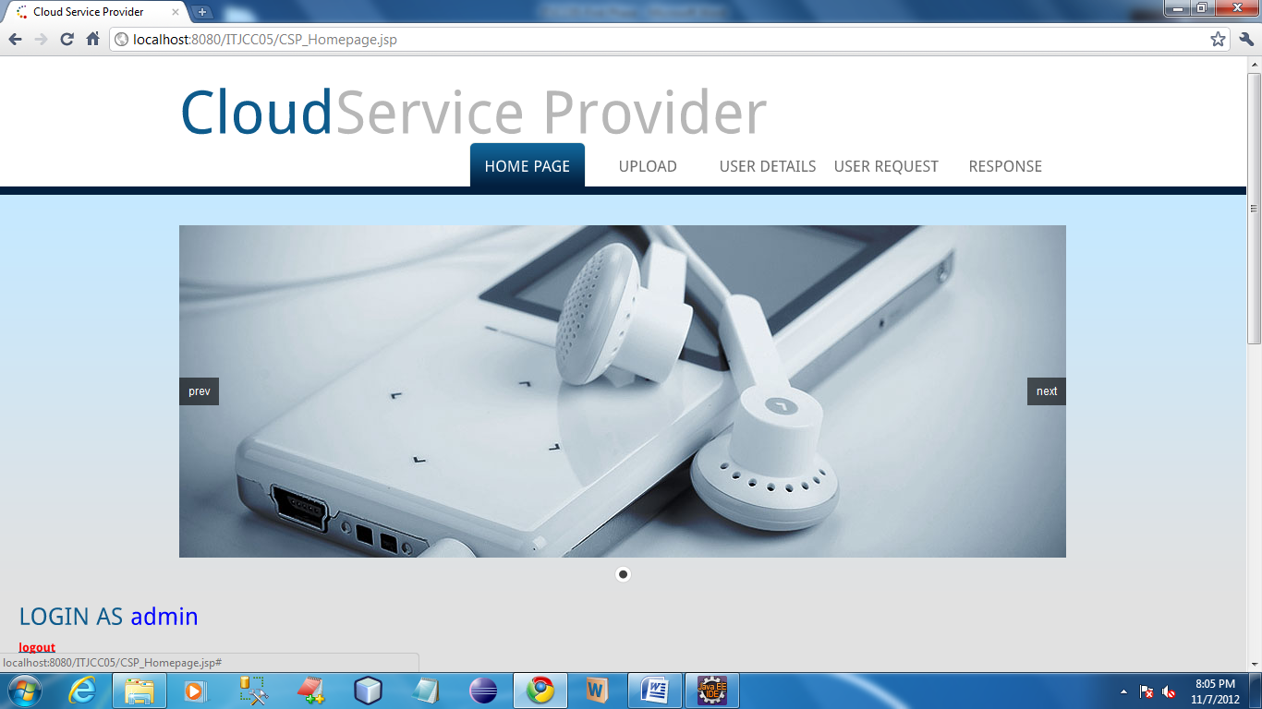

Slide 34
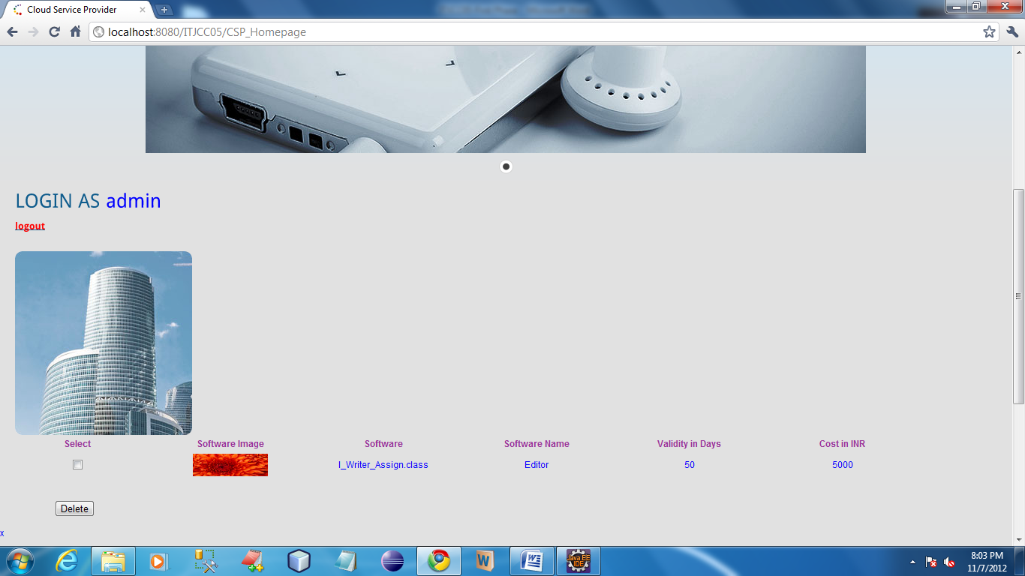

Slide 35
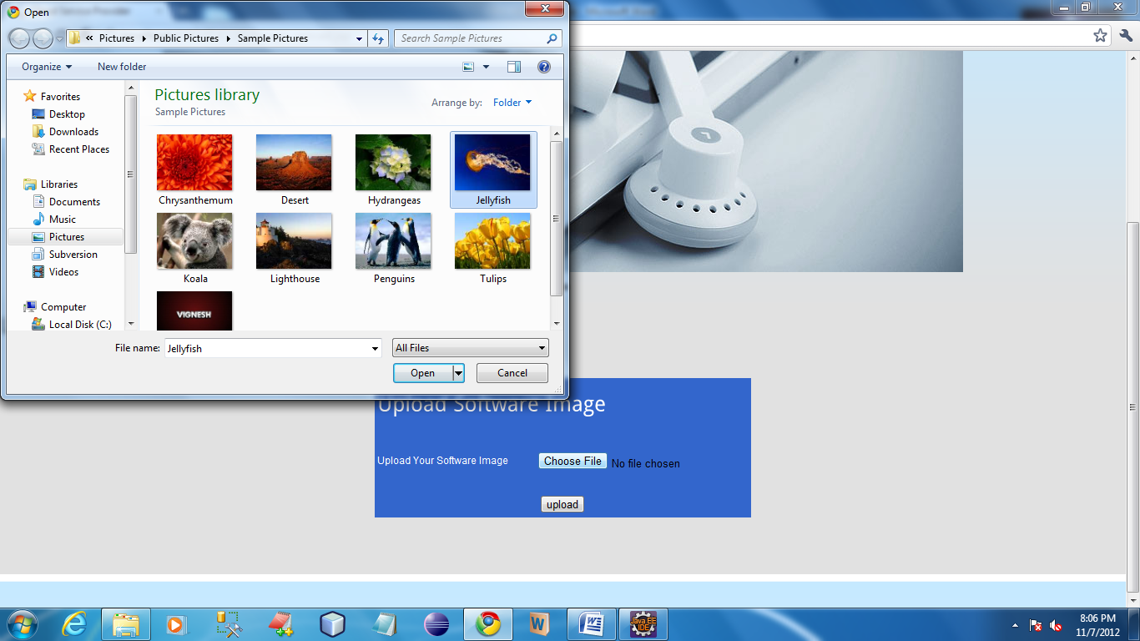

Slide 36
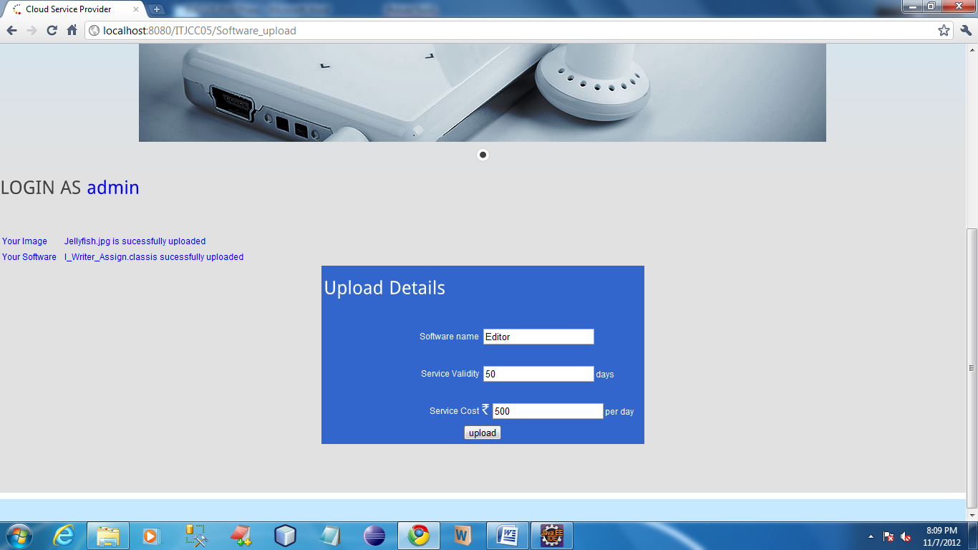

Slide 37
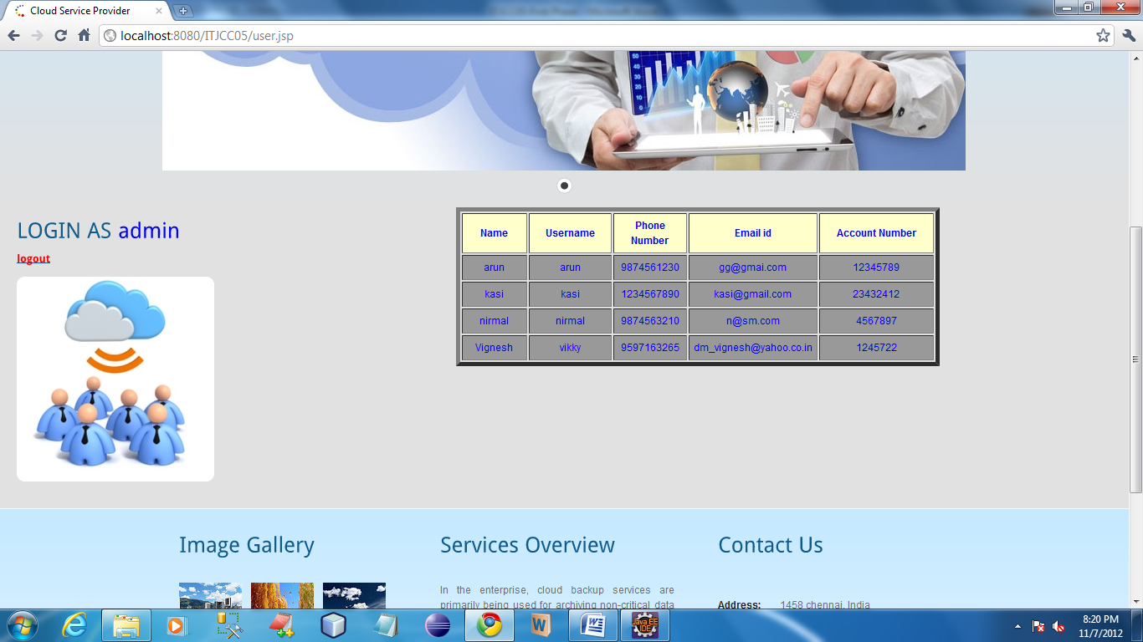

Slide 38
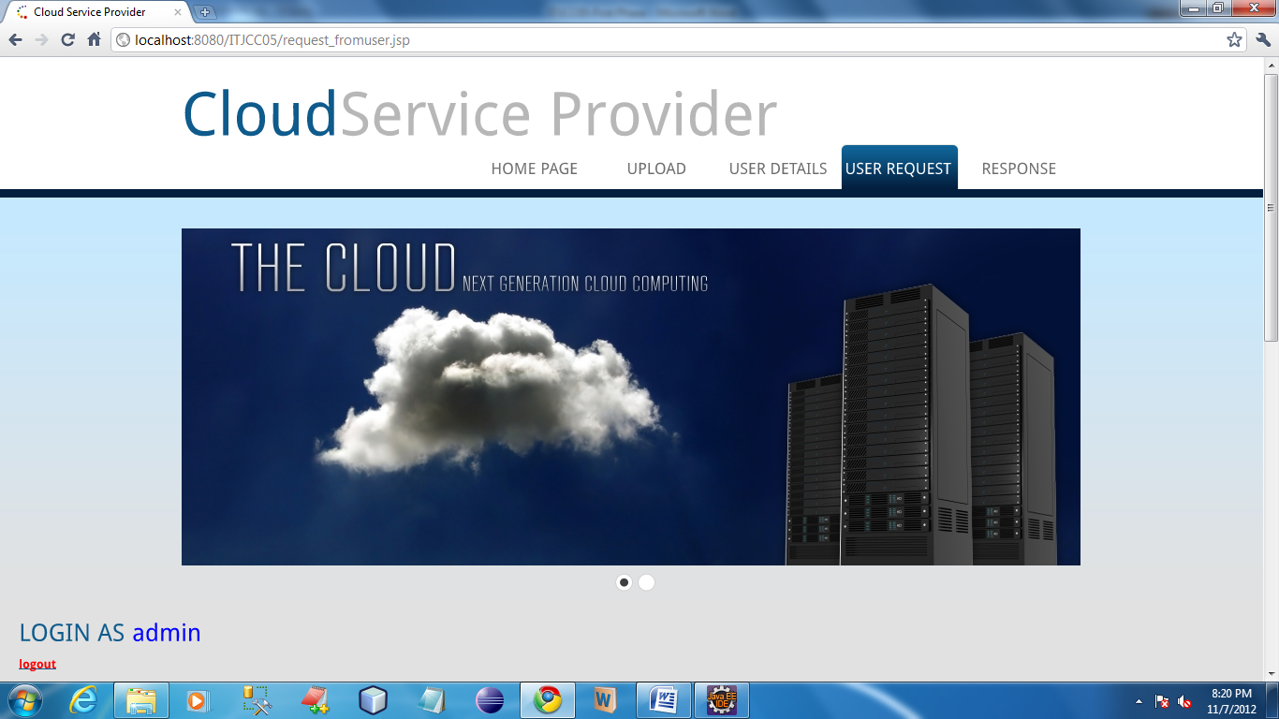

Slide 39
USER

Slide 40
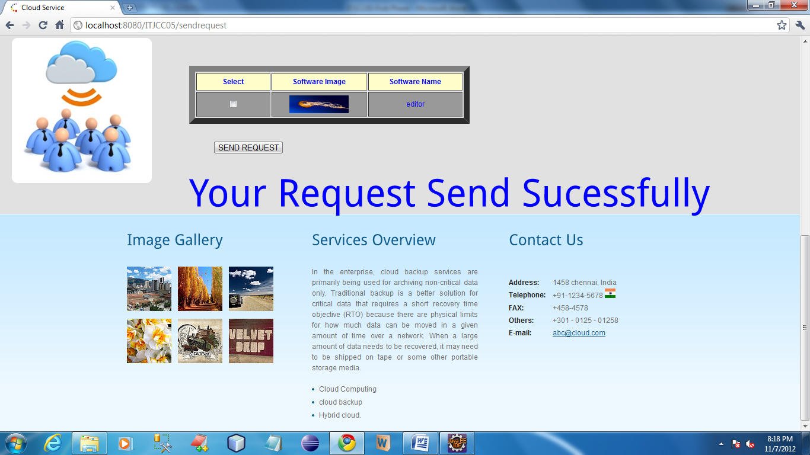

Slide 41
